Slide 1
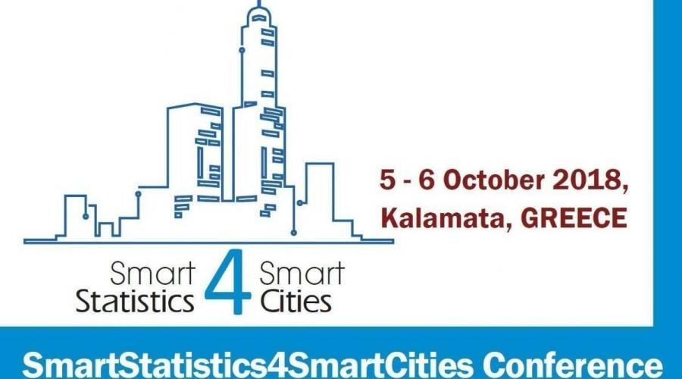
Smart Tourism statistics: improving the range of service offering in Rome
Massimo De Cubellis
Istat -Italy

Slide 2
Index
Smart Tourism statistics in Rome Municipality
the stakeholders
the project idea
Experiments and projects on Smart Statistic – National / International context
How do data-sources and data-processing change ?
First results
New challenge and outstanding problems
Smart Tourism statistics: improving the range of service offering in Rome – SMARTSTATISTICS4SMARTCITIES
Kalamata, 5-6 October 2018

Slide 3
Smart Tourism statistic in Rome: the stakeholders
Istat
is involved in several experiments on Smart Statistics and is interested to approach projects Smart Cities oriented
a collaboration with the Rome Municipality and Italian Digital Transformation Team has been started in June 2018
Rome Municipality
January 2018 - has signed an agreement with Ericsson for the implementation of 5G network (ICT service provider)
February 2018 - turn on the first 5G antenna
May 2018 – has become one of the European pilot cities for Smart City applications
September 2018 - has signed a Memorandum of understanding with Fastweb (MPD provider) to start an experimentation, aimed at developing of definition on some projects in the context of Smart City and IoT
Smart Tourism statistics: improving the range of service offering in Rome – SMARTSTATISTICS4SMARTCITIES
Kalamata, 5-6 October 2018

Slide 4
Smart Tourism statistic in Rome: the stakeholders
Italian Digital Transformation Team
Is born to build the "operating system" of the country, a series of fundamental components on top of which we can build simpler and more efficient services for the citizens, the Public Administration and businesses, through innovative digital products (Data Analytics Framework, Public Digital Identity System, Electronic Identity Card, API Ecosystem, etc.)
in this project it provides the Data Analytics Framework (DAF) with the goal of improving and simplifying the interoperability and exchange of data between Public Administrations, promoting and improving the management and usage of Open Data, optimizing activities of analysis and knowledge generation.
Smart Tourism statistics: improving the range of service offering in Rome – SMARTSTATISTICS4SMARTCITIES
Kalamata, 5-6 October 2018

Slide 5
Smart Tourism statistics in Rome: the project idea
The objective
Evaluate the supply and demand of museum services based on the nationality of the tourists, using the mobile phone data.
Datasets to use:
Official Statistics on Tourism (source: Istat)
Statistics on Museums (describes the structural features, the services offered, the activities carried out and the use of museums)
Statistics on tourist accomodation
Data on the daily tickets sold in the museums (source: Rome Municipality)
Mobile Phone Data (source MPC provider)
Data on the presence in Rome of tourists, divided by nationality, gender, age, etc.
Smart Tourism statistics: improving the range of service offering in Rome – SMARTSTATISTICS4SMARTCITIES
Kalamata, 5-6 October 2018

Slide 6
Smart Tourism statistics in Rome: the project idea
The Use Case
Supply of museum services divided by each museum (ticket office, assistance in the hall, audio/video guide (in English, French, German, Spanish, Japanese, Chinese, …), coffee bar, Card Rome Pass 48 hours, didactics, vending machines for food and drink, wardrobe, organization of events and/or exhibitions, small point of sale of editorial products related to the museum, etc.)
Demand of museum services: integrate the data available (MPD, tourist accomodation, daily tickets sold), with the aim to profile the demand of services, based on nationality, age group, gender, type of accomodation, etc.
Analysis of the supply and demand of museum services, using data analytics techniques (e.g. data visualization) to assess whether the services offered are adequate to the demand. The aim is to provide (smart) statistics at Rome Municipality to make decisions on the services to propose in the museums.
Smart Tourism statistics: improving the range of service offering in Rome – SMARTSTATISTICS4SMARTCITIES
Kalamata, 5-6 October 2018

Slide 7
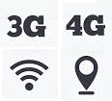
Analysis supply and demand of museum services
SUPPLY OF MUSEUM SERVICES
DEMAND OF MUSEUM SERVICES
DATA SOURCES
MOBILE PHONE DATA (MPD Provider)
OFFICIAL STATISTICS ON MUSEUMS (Istat)
TICKET SOLD DATA (Rome Municipality)
OFFICIAL STATISTICS ON ACCOMODATION (Istat)
DATA PROCESSING
Data Analytics
Data Visualization
DATA ANALYTICS FRAMEWORK (Digital Transformation Team)
SMART STATISTICS for ROME MUNICIPALITY
Smart Tourism statistics: improving the range of service offering in Rome – SMARTSTATISTICS4SMARTCITIES
Kalamata, 5-6 October 2018

Slide 8
Experiments and projects on Smart Statistic – National Context – Istat Participation
Implementation of a system to monitor the road network and vehicular traffic flows, through the use of new data sources to improve traffic accident statistics.
Smart City
Enhancement of information available on green areas through the use of new data sources and deep learning techniques
Traffic flows
Environment
National context (Istat)
Google Traffic web-cam
Mobility
Tele-detected images participated mapping
Population estimate and commuting
New data sources to integrate administrative data and to create models to validate population estimates and analyze the commuting's phenomenon
Mobile Phone Data
Smart Tourism statistics: improving the range of service offering in Rome – SMARTSTATISTICS4SMARTCITIES
Kalamata, 5-6 October 2018

Slide 9
Experiments and projects on Smart Statistics - International context
Istat participation
Network of NSO experts engaged in the study of how to produce smart statistics through the extensive use of IoT
H2020 Project
MaksWell project :use of Big sources to extend and harmonize indicators on well-being and social progress at European level
ESSnet Trusted Smart Statistics
International context
Urban sensors
Vehicle sensors
Other smart devices
Big Data
Use Case
Study the use of smart electric meters to produce statistics on housing, household expenses, environmental impact and energy production
Smart farming
Pilot projects
Design Smart Statistics in addition to existing data sources using new Big and Smart sources
Smart mobility
Smart meters
Satellite-images of agricultural areas
Sensors of agricultural vehicles
Implement APP for multi-modal travel planning, that consider: travel time, environmental impact, travel cost and safety
App
Smart Tourism statistics: improving the range of service offering in Rome – SMARTSTATISTICS4SMARTCITIES
Kalamata, 5-6 October 2018

Slide 10
How do data-sources and data-processing are changing in Istat’s experimental projects ?
2013
2016
Big Data
S m a r t s t a t i s t i c s
DATA SOURCES
Internet data (web scraping)
Google Traffic web-cam
Smart meters
Vehicle sensors
Social Media
Satellite-images of agricultural areas
Mobile Phone Data
Urban sensors
Weareable Devices
Other Big data Source
Tele-detected images participated mapping
Sensors of agricultural vehicles
App
DATA PROCESSING
D A T A C O L L E C T I O N
D A T A A N A L Y S I S
Smart Tourism statistics: improving the range of service offering in Rome – SMARTSTATISTICS4SMARTCITIES
Kalamata, 5-6 October 2018

Slide 11
First results
what we have already learned
New domains
Interaction and integration between sources
Multiple use of the same sources for different domains
Investigation and continuous "discovery" of new possibilities of analysis
what we have already got
Acquisition of experience
Wareness of the potentials and limitations of the IoT
Specific skills on generalized tools for processing / analyzing large data sources (Cloudera, machine / deep learning techniques)
Closer relations with other public and private entities
Smart Tourism statistics: improving the range of service offering in Rome – SMARTSTATISTICS4SMARTCITIES
Kalamata, 5-6 October 2018

Slide 12
New challange and outstanding problems
New challeng and next activities
Continue activities on ongoing projects, with the aim of overcoming criticalities and improving quality
Extend already used data sources to new statistical domains (e.g. mobile data for tourism statistics)
Extend the field of IoT technologies used for statistical purposes (e.g. wearable devices for statistics on wellness and quality life)
Outstanding problems
external sources are not always "available and open"
constraints of the privacy guarantor on the use of data (e.g. mobile telephony)
territorial data (e.g. mobile telephony) don’t reflect the administrative subdivision of the territory (e.g. municipal level) used in traditional surveys
Production times can not be easily estimated (even for reasons outside the NSO)
The border between official statistics, experimental statistics and trusted smart statistics is not yet easy to feel
Smart Tourism statistics: improving the range of service offering in Rome – SMARTSTATISTICS4SMARTCITIES
Kalamata, 5-6 October 2018

Slide 13
Thanks for your attention
Contact:
massimo.decubellis@istat.it
Smart Tourism statistics: improving the range of service offering in Rome – SMARTSTATISTICS4SMARTCITIES
Kalamata, 5-6 October 2018

